Slide 1

CSE-443 Six Weeks Summer Training
Presentation
Presented By-
Abhishek Agarwal
11904125

Slide 2
ABOUT TRAINING
Course Name: Web-Design for Everybody Specialization
Mode of Training: Online from Coursera
Start Date: 28th May 2021
End Date: 08th July 2021
Duration: Six Weeks

Slide 3
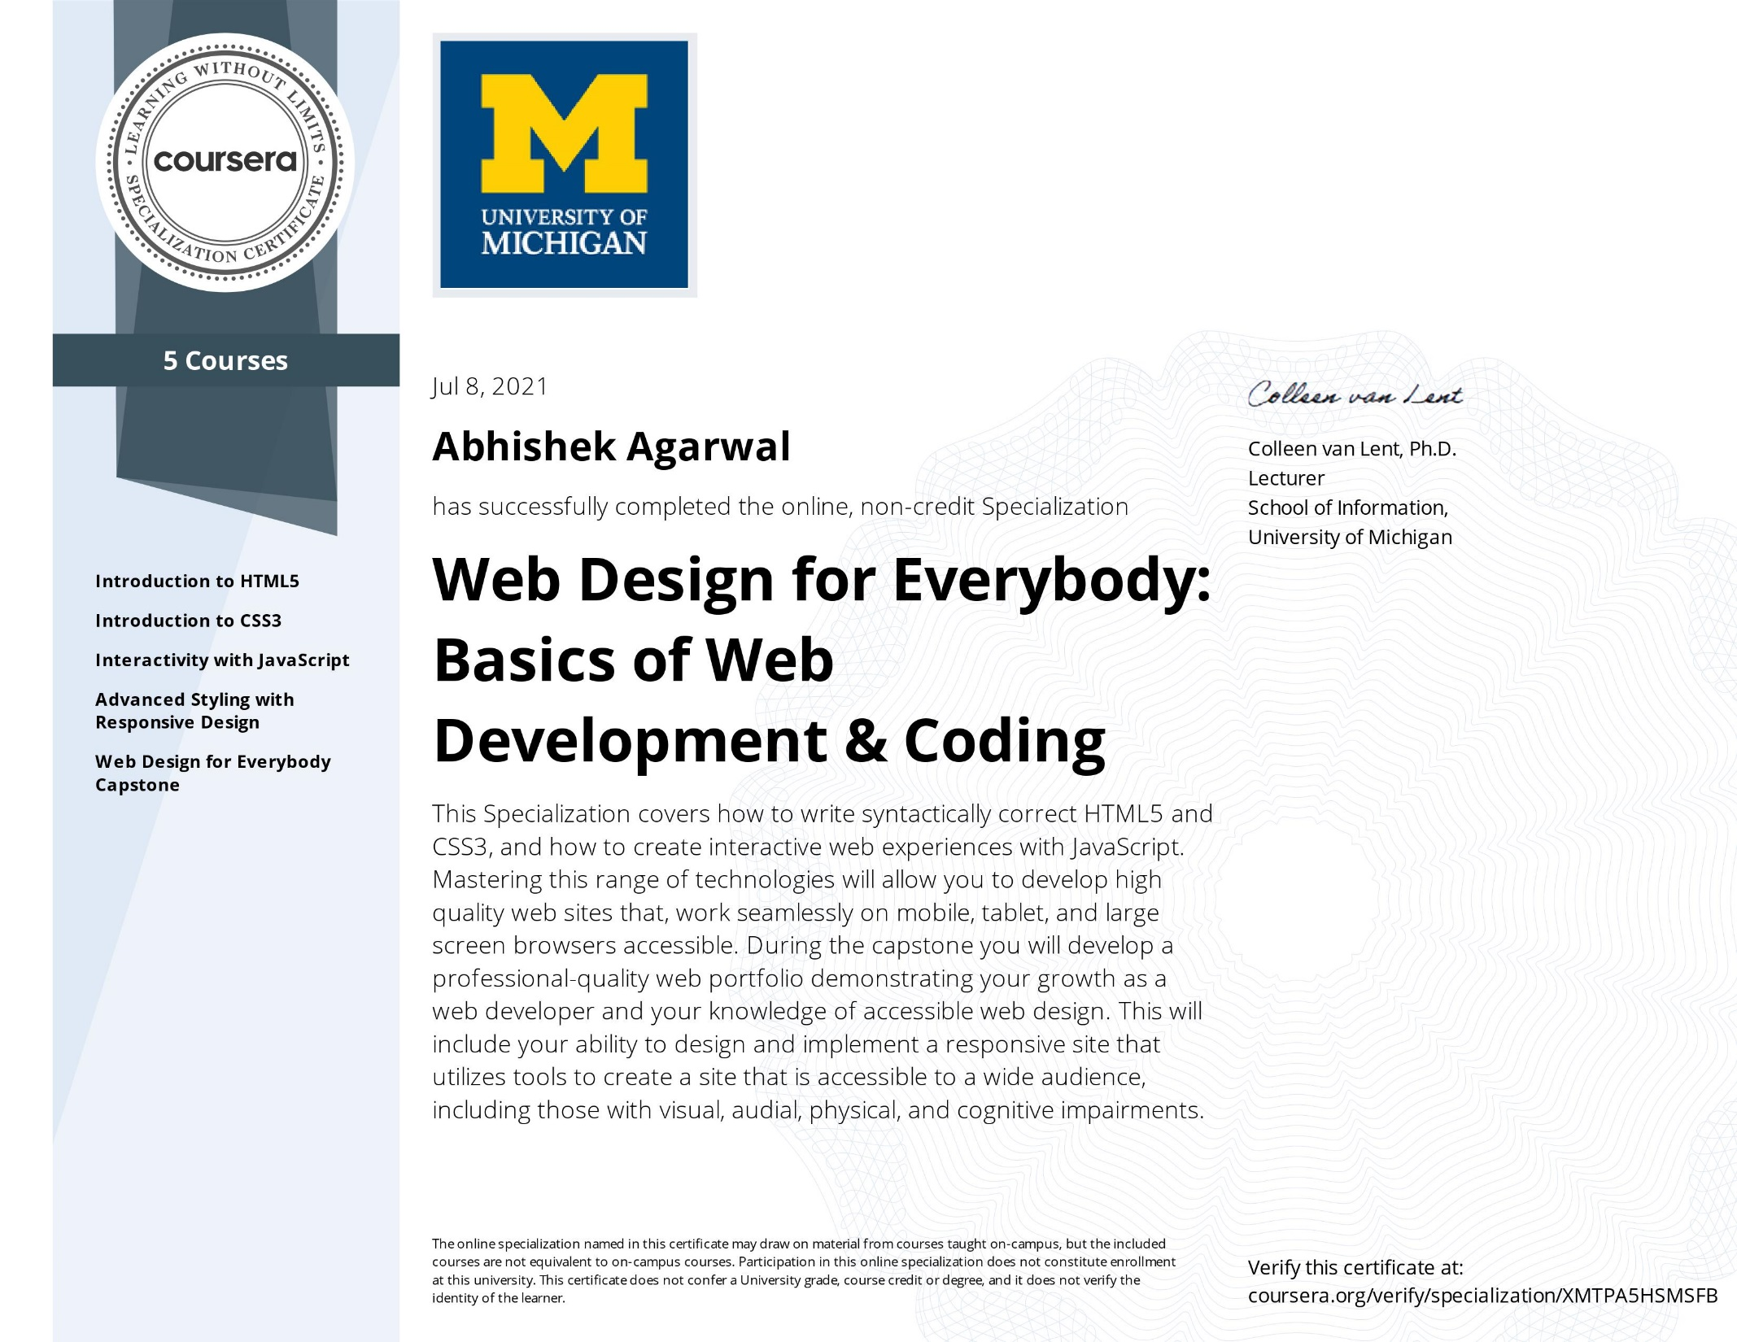

Slide 4
CONTENTS
WEB DEVELOPMENT
WEB DEVELOPMENT TYPES
HTML
CSS
JAVASCRIPT

Slide 5
Web Development
Web development refers to the building, creating, and maintaining of websites. It includes aspects such as web design, web publishing, web programming, and database management. It is the creation of an application that works over the internet i.e. websites.
The word Web Development is made up of two words, that is:
Web: It refers to websites, web pages or anything that works over the internet.
Development: Building the application from scratch.

Slide 6
Web Development can be classified into two ways:
Front-end web development, also known as client-side development is the practice of producing HTML, CSS and JavaScript for a website or Web Application so that a user can see and interact with them directly. The challenge associated with front end development is that the tools and techniques used to create the front end of a website change constantly and so the developer needs to constantly be aware of how the field is developing.
Back end Development refers to the server side of development where you are primarily focused on how the site works. Making updates and changes in addition to monitoring functionality of the site will be your primary responsibility. This type of web development usually consists of three parts: a server, an application, and a database. Code written by back end developers is what communicates the database information to the browser. Anything you can’t see easily with the eye such as databases and servers is the work of a back end developer. Back end developer positions are often called programmers or web developers.

Slide 7
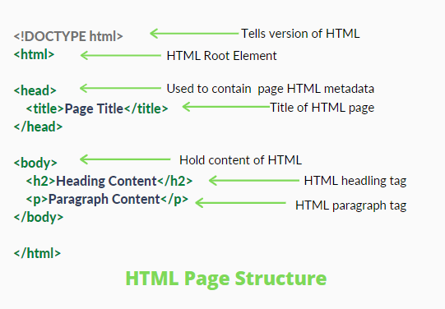
HTML
HTML stands for Hyper Text Mark-up Language. It is used to design web pages using mark-up language. HTML is the combination of Hypertext and Mark-up language. Hypertext defines the link between the web pages. Mark-up language is used to define the text document within tag which defines the structure of web pages. HTML 5 is the fifth and current version of HTML. It has improved the mark-up available for documents and has introduced application programming interfaces(API) and Document Object Model(DOM).

Slide 8
CSS
CSS stands for Cascading Style Sheets. It is a style sheet language which is used to describe the look and formatting of a document written in markup language. It provides an additional feature to HTML. It is generally used with HTML to change the style of web pages and user interfaces. It can also be used with any kind of XML documents including plain XML, SVG and XUL.
CSS is used along with HTML and JavaScript in most websites to create user interfaces for web applications and user interfaces for many mobile applications.
What does CSS do:
To add new looks to your old HTML documents.
To completely change the look of your website with only a few changes in CSS code.

Slide 9
JavaScript
JavaScript is a lightweight, cross-platform, and interpreted scripting language. It is well-known for the development of web pages, many non-browser environments also use it. JavaScript can be used for Client-side developments as well as Server-side developments. JavaScript contains a standard library of objects, like Array, Date, and Math, and a core set of language elements like operators, control structures, and statements.
Client-side: It supplies objects to control a browser and its Document Object Model (DOM). Like if client-side extensions allow an application to place elements on an HTML form and respond to user events such as mouse clicks, form input, and page navigation. Useful libraries for the client-side are AngularJS, ReactJS, VueJS and so many others.
Server-side: It supplies objects relevant to running JavaScript on a server. Like if the server-side extensions allow an application to communicate with a database, and provide continuity of information from one invocation to another of the application, or perform file manipulations on a server.

Slide 10
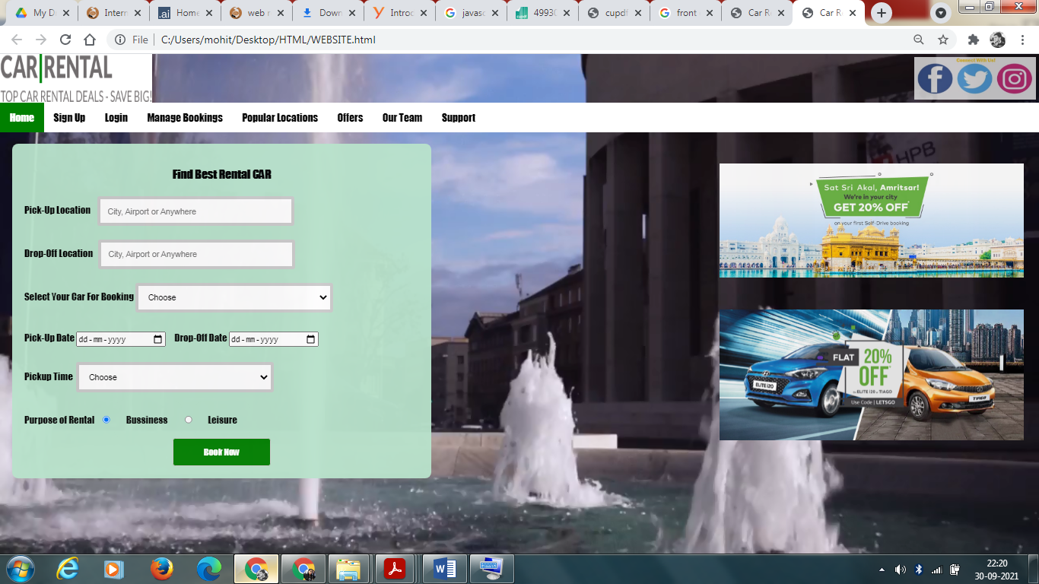
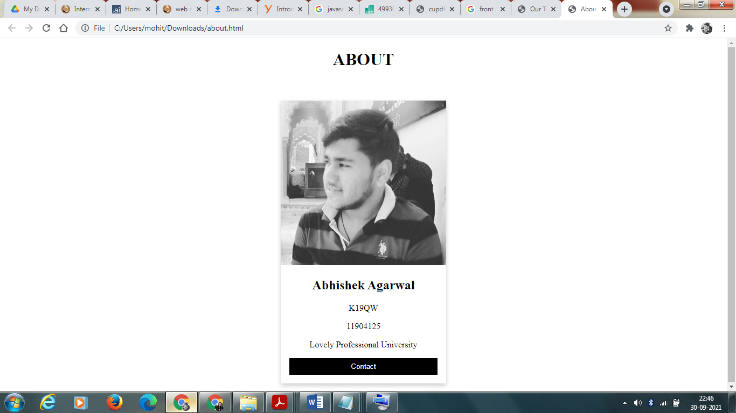
Project Work

Slide 11
THANK YOU

